Slide 1



Green Skills
Our Role in Sustainable Development

Slide 2
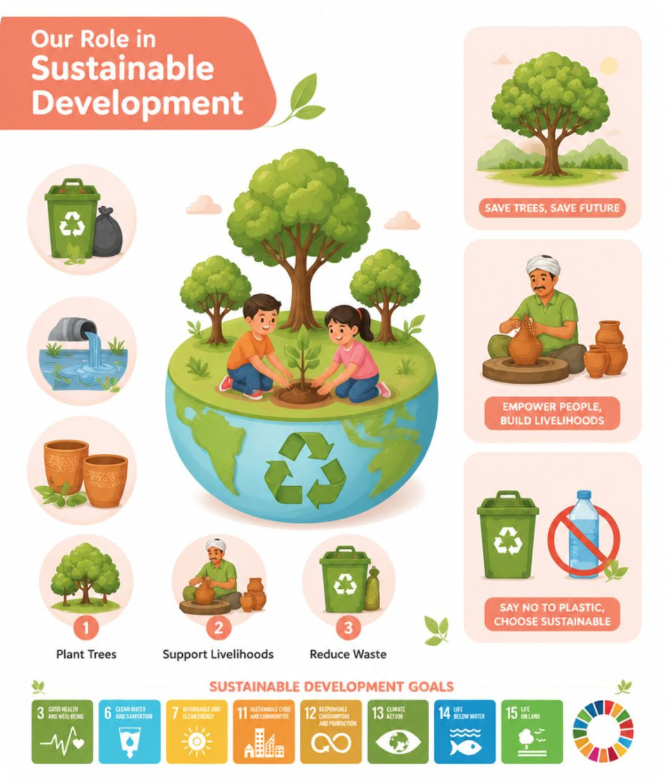

Our Role in Sustainable Development
Why It Matters
As our population grows, so does the pressure on natural resources. We must act wisely.
Increasing population demands more natural resources
We must balance consumption with environmental protection
United Nations has set 17 Sustainable Development Goals (SDGs) to guide global action
The Ministry of Railways in Varanasi and Raibareilly introduced clay pots, or Kulhads, to replace plastic and paper cups.
Reduces cutting of trees needed to make paper cups
Creates jobs for potters and supports the local economy
Helps reduce plastic waste

Slide 3



Quality Education & Clean Water
Quality Education
Education helps us become aware of our role as a responsible citizen.
We should:
Use the facilities present in our areas
Take our friends to school
Help friends study
Stop friends from dropping out of school
Clean Water & Sanitation
We must make efforts to make India free of open defecation by building toilets and creating awareness towards sanitation.
Industrial pollution is polluting our water resources, which will cause scarcity of clean drinking and usable water.

Slide 4
Affordable & Clean Energy
Solar Power
Biogas & Renewables
Power generated using the sun does not cause pollution because it does not require burning non-renewable fuels such as coal. We are making efforts to increase solar power generation so our electricity needs are met while reducing environmental harm and conserving natural resources.
Biogas is an eco-friendly alternative to natural gas and other conventional fuels. Renewable energy sources like biogas help protect natural resources while providing cleaner energy for communities.

Slide 5

Decent Work & Economic Growth
1
2
3
1. Study and Find Good Jobs
2. Work Hard
3. Learn and Develop
Skills
We can study and find good jobs to take care of ourselves and our families.
We can work hard and contribute to society.
We can learn and develop skills so that we add value in our community.

Slide 6
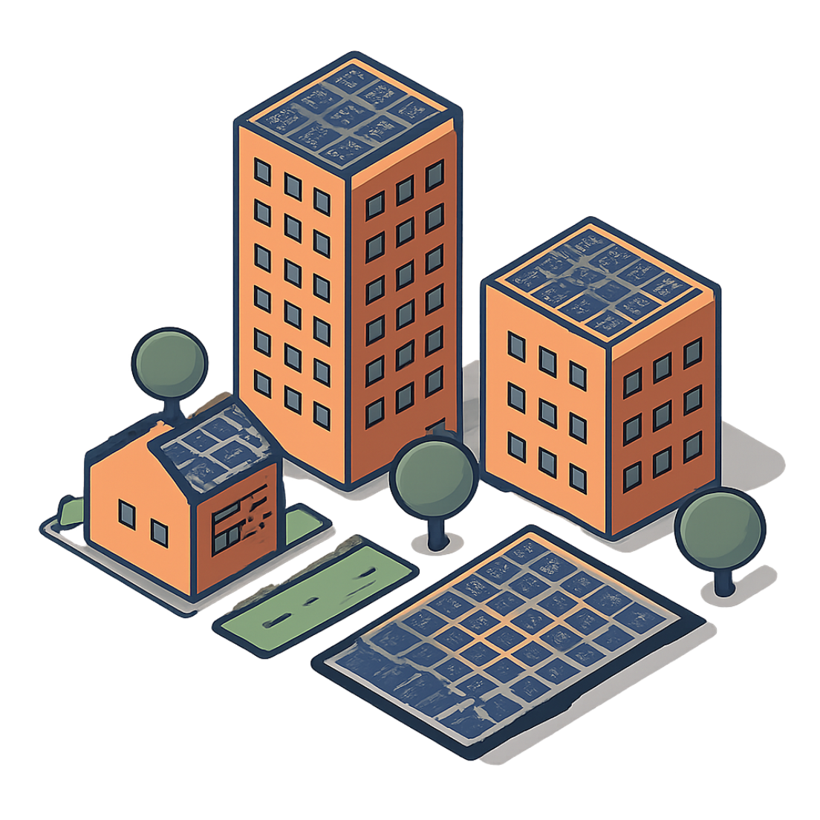
Reduced Inequalities & Sustainable Cities
Include Everyone
To reduce inequalities we can:
Be helpful to one another
Be friendly with everyone
Include everyone while working or playing
Help others by including everyone whether they are small or big, girl or boy, or belong to any class or caste
Save Energy at Home & School
Save energy by switching off lights and fans when not in use
Use natural light as much as possible
Use energy efficient lights (LED bulbs) and appliances

Slide 7

Responsible Consumption & Production
Make Greener Choices Every Day
Reuse paper, glass, plastic, water, and other materials whenever possible
Take cloth bags to the market for carrying fruits and vegetables
Donate things we do not use, such as clothes, books, furniture, and food
Buy and eat seasonal fruits and vegetables from local growers
Repair leaking taps and pipes to avoid wasting water
Sort and treat garbage before disposing of it

Slide 8
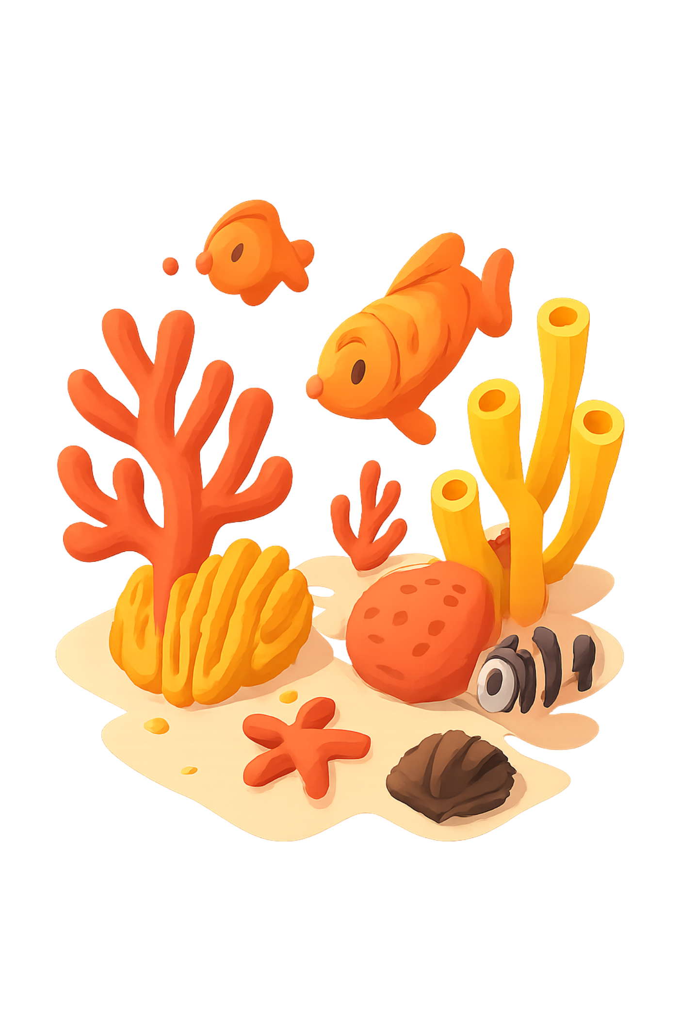
Life Below Water & Life on Land
Protect Marine Ecosystems
Plant Trees
Tons of plastic is found in the seas, which is killing marine life. Protecting marine life and saving our oceans from pollution is necessary to preserve the marine life.
Cutting of trees is leading to soil erosion and making land dry and unusable for cultivation. Planting more trees to replace the ones that we have cut is an important step towards sustainable development.

Slide 9
1. Give any two examples of how individual choices and behaviours can contribute in achieving sustainable development. [2 marks]
Any two examples, such as:
(i) Reducing, reusing and recycling paper plastic, glass and water instead of discarding them.
(ii) Using public transport, cycling or car-pooling instead of using private vehicles for every trip, to reduce fuel consumption and pollution.

Slide 10
2. List any two Green Skills that can contribute to a sustainable environment. [2 marks]
Any two, such as:
(i) Efficient use and conservation of resources like water and electricity.
(ii) Sustainable/organic farming practices.

Slide 11
3. List any three ways in which an individual can contribute to sustainable development. [3 marks]
Any three:
(i) Reuse paper, glass, plastic and water rather than discarding them.
(ii) Carry cloth bags instead of using plastic bags.
(iii) Donate unused clothes, books, furniture or food.
(iv) Buy and eat seasonal, locally-grown fruits and vegetables.
(v) Repair leaking taps and pipes to avoid wasting water.

Slide 12
4. How can efficient use of electricity help in sustainable development? Give any two points. [2 marks]
(i) Turning off lights and unplugging appliances when not in use reduces unnecessary consumption of electricity, most of which is generated from fossil fuels.
(ii) Choosing renewable, clean sources of energy such as solar power reduces dependence on non-renewable resources and lowers pollution and carbon emissions.

Slide 13
5. Suggest any two measures for water management at the individual/household level. [2 marks]
(i) Use water wisely; turn off the tap when not in use.
(ii) Get leaking taps and pipes fixed immediately, and treat waste/drain water properly before it is allowed to flow into local water bodies

Slide 14
6. What steps can be taken to save forests from being cut down? (Any two) [2 marks]
(i) Save and recycle paper so that fewer trees need to be cut for paper production.
(ii) Avoid buying products made from wild animals (leather, fur, ivory) that drive deforestation, and collect forest produce like honey without destroying habitats such as beehives.

Slide 15
7. Why should polluting industries be relocated away from populated/city areas? [2 marks]
Polluting industries release waste into air and water near where people live, contaminating resources that people and animals depend on for drinking and daily use, which harms public health over time. Relocating them away from populated areas reduces this direct exposure and helps protect the health of city residents.

Slide 16
Thank You X A Group 9 - RISHIK - SHREYAS - SRUJAN

